Slide 1
Step-By-Step
Cultural Sensitivity Recovery and Resiliency Training Program
Implementing best practices (Evidenced Base Practice) –developing cultural competency in the IOP Program

Slide 2
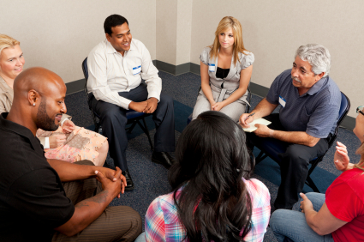
Developing culturally competent services
Improving treatment services for cultural groups

Slide 3
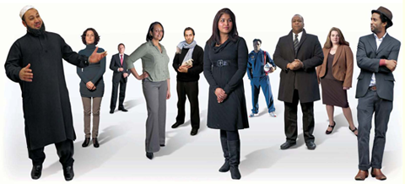
Honoring Diversity:
“Stand If…” Activity

Slide 4
Learning objectives
Understand how one’s worldview, biases, and assumptions impact relationships with others, including co-workers, clients, and community stakeholders
Explore the Cultural Competence Continuum as a personal and organizational evaluation tool
Discuss strategies for enhancing cultural competence to improve relationships and perform better in the work setting
Learn about the benefit of demonstrating culturally competent attitudes and behaviors in an organizational setting

Slide 5
Take Home Messages
Cultural Competence = Relationship Building
INDIVIDUAL - Get to know yourself (worldview, values, cultural identities) so you can better explore the uniqueness of others
ORGANIZATION - Get to know your community (traditions, cultures, norms, practices, beliefs) so your agency can be more in tune with their assets & needs
SYSTEMS – Get to know your agency (culture, mission, values, staff, services, polices, practices, philosophies) so you can better serve the community

Slide 6
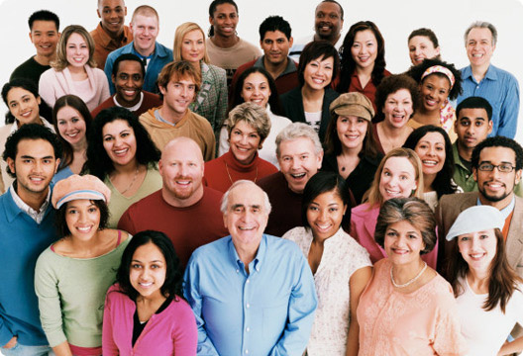
Culture can be defined as…
“… vast structures of behavior, ideas, attitudes, values, habits, beliefs, customs, language, rituals, ceremonies, and practices peculiar to a particular group of people…[that]…provides them with a general design for living and pattern for interpreting reality…” Wade Nobel, M.D., TA Partnership (2007)

Slide 7
Culture
BEHAVIOR
Actions
ATTITUDES
Values, Beliefs, Judgments
KNOWLEDGE
Thoughts/Awareness

Slide 8
Cultural Considerations:
Ethnicity
Race
Country of Origin
Gender
Age
Socio-economic Status
Primary Language
English Proficiency
Spirituality / Religion
Literacy Level
Sexual Orientation
Employment
Geographic Location
Physical Ability/Limitations
Immigration Status
Criminal Justice Involvement
Political Climate
Notes:
8

Slide 9
CULTURAL IDENTITIES
RACE
AGE
GENDER
FAMILY AND COMMUNITY SUPPORT
OPPRESSION EXPERIENCE
SES
RELIGION
BELIEFS
VALUES
EDUCATION
ACCULTURATION
LANGUAGE
SOCIAL IDENTITY
IMMIGRATION
STATUS
URBANICITY
ABILITY
DISABILITY
(Hidden)

Slide 10
You as a Culturally Diverse Entity
YOU

Slide 11
What if…
Think about two of your most important cultural identities on the diagram…
  Pretend that someone knew everything about you except those two important cultural identities.
  Now, pretend those two important cultural identities were discussed in a negative way.
Notes:
11

Slide 12
Culture Shapes Worldview
“A culturally based variable that directly affects and mediates our belief systems, assumptions, modes of problem solving, decision making and conflict resolutions (Ibrahim, 1991):
An individual's perception of his or her relationship with the world, i.e., nature, institutions, people, and things (Sue, 1978).
Notes:
12

Slide 13

“At least half of the exercise I get everyday comes from jumping to conclusions.”
Bruce Dexter, Journalist
Notes:
Share Talking Points
Jumping to conclusions may be like going through a ring of fire, it can be very dangerous, producing unintended consequences based on our assumptions. Would anyone like to describe a time when assumptions were made about you that led to discrimination, or even a time when you have made assumptions?
Self-awareness of our own cultural identities and stereotypes will allow us to improve cross-cultural interactions. Think about your thoughts and actions…
Distinguish between the “intent” and the “impact” of your behavior
Notice how you assign status and importance to individuals
Review your negative reactions to others and ask yourself “What am I responding to and why?”
Moreover, exercising our ability to NOT make assumptions about others will better enable us to provide culturally competent service delivery.

Slide 14


Cultural Differences = Culture Clash?

Slide 15

Creating Prejudice:
How we learn to discriminate
The Cycle of Conditioning:
We are all influenced by our environment.
  Prepare
  Separate groups
  Differences pointed out
  Justify marginalized group’s behavior
  Continue cycle-reinforced stereotypes
Notes:
Directions
Let the participants know that they are about to watch a film entitled, “A Class Divided”.
Share Talking Points
In this film, we will learn about how discrimination is taught through the cycle of conditioning. (Introduce briefly the cycle of conditioning, as per the presentation slide.)
How discrimination is taught:
Prepare - use a person that is trusted to share grossly inaccurate information
Separate groups so they can not learn about the other
Differences pointed out - use isolated incidents or one individual’s behavior to stereotype to a larger group
Justify marginalized group’s behavior
Continue cycle-reinforced stereotypes
Pay close attention to what happens in the film, and how our expectations can shape another group’s behavior.
Recommended term to explore: Prejudice, an emotional commitment to a particular point of view, not swayed by contradictory evidence.

Slide 16
Video: “A Class Divided”
Jane Elliot
http://www.pbs.org/wgbh/pages/frontline/shows/divided/
Keep in mind the cycle of conditioning.
Note your reactions.
Have you seen this in other settings?
Notes:
Directions
Show the participants Part 5 of the Video, which is entitled, “How the adults reacted”. It is 14 minutes and 45 seconds in duration. If more than two hours is allotted for the training, it may be beneficial to watch Part 4 of the video as well. The video can be viewed online at: http://www.pbs.org/wgbh/pages/frontline/shows/divided/

Slide 17
Discussion about Video
What did you notice about yourself and your reactions / feelings?
Have you ever felt left out, different, or discriminated against?
How did the cycle play out?
How do you see the cycle playing out in society today?
How do we break or interrupt this cycle?
Notes:
Debrief Activity
Place the participants in pairs or small groups so they can answer the questions noted on the presentation slide. After they spend time sharing, ask them to report their responses to the larger group for further processing.
Share Talking Points
In this video, we get a sense of how our worldview, biases, and assumptions impact relationships with others. Before prison staff members were introduced to Jane’s experiment, they were probably a more cohesive group. With a changed worldview and new assumptions, the staff members worked in opposition to one another based on the distinctions made between blue-eyed and brown-eyed people. How might the worldviews and assumptions of service providers impact how they engage and serve community members?
17

Slide 18

Cross-cultural Interactions
“We all use stereotypes, all the time, without knowing it. We have met the enemy of equality, and the enemy is us.”
~ Article from Psychology Today

Slide 19

Breaking the Cycle by
Becoming More Mindful
“Promising evidence in social cognitive psychology indicates that with sufficient motivation, cognitive resources, and effort, people are able to focus on the unique qualities of individuals, rather than on the groups they belong to, in forming impressions and behaving toward others.”
From Reducing Racial Bias Among Health Care Providers: Lessons from Social-Cognitive Psychology
Notes:
Directions
The facilitator should read the presentation slide.
Share Talking Points
A Person who Negatively Stereotypes can Change! The negative stereotypes associated with many immigrant groups, for example, have largely disappeared over time. For African-Americans, civil rights laws forced integration and nondiscrimination, which, in turn, helped to change public opinion.

Slide 20

Reducing the Impact of Stereotyping
These efforts may, over time, reduce the strength of stereotyping:
Commit to change.
Monitor and attempt to make better hidden attitudes before they are expressed through behavior.
Make a conscious decision to be egalitarian, which may lead one to widen one's circle of friends and knowledge of other groups.

Slide 21

How does Cultural Competence relate to your work?

Slide 22
Common Critiques of Cultural Competency
It’s a Soft Construct because:
It’s not skill-based
It’s not data-driven
It’s not linked to specific outcomes
It’s hard to operationalize
Notes:
22

Slide 23

Cultural competence enables a person to…
Value the differences/similarities between persons and groups
Make the knowledge of a culture a part of oneself
Focus on one’s strengths and capacities
Recognize the importance of a person’s life context

Slide 24
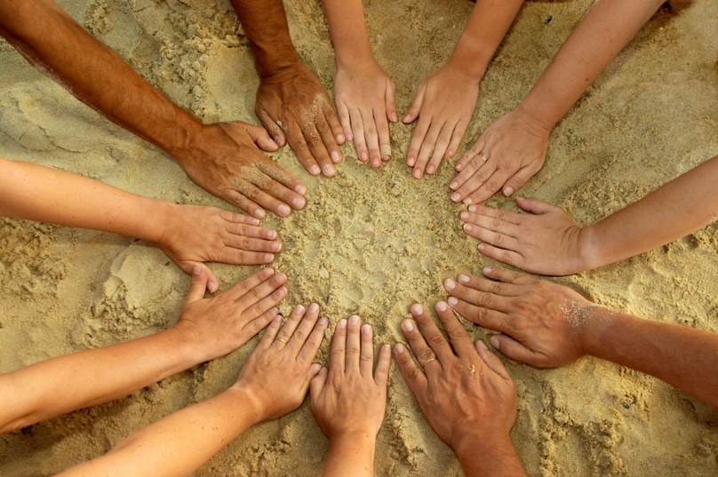
Cultural competence enables an agency to…
    Respond to demographic changes in the community
    Work towards eliminating disparities in the health status of multicultural people
    Improve quality of services & outcomes
    Meet legislative, regulatory, & accreditation mandates
    Gain a competitive edge in the marketplace
    Provide community focused service delivery
    Enhance the workplace environment
Notes:
Directions
The facilitator should read the presentation slide.

Slide 25
What is Cultural Competence?
Multidimensional Construct
Individual / Provider Level
Organizational Level
Systems Level
Notes:
25

Slide 26

Cultural Competence
“A process of learning that leads to an ability to effectively respond to the challenges and opportunities posed by the presence of cultural diversity in a defined social system.”

Slide 27
Elements of Cultural Competence
Awareness of one’s own culture
Understanding the dynamics of difference
Awareness and acceptance of difference
Development and application of cultural knowledge
Celebration of diversity

Slide 28
Cultural Competence
“To be culturally competent doesn’t mean you are an authority in the values and beliefs of every culture. What it means is that you hold a deep respect for cultural differences and are eager to learn, and willing to accept that there are many ways of viewing the world.”
Dr. Okokon O. Udo

Slide 29
Quick Self-Check Using the Cultural Competence Continuum
What Stage Are You In? | Characteristics
RED | attitudes, behaviors, values, and practices that are destructive to a cultural group
ORANGE | lack of skill and knowledge to respond effectively to the needs, interests and preferences of culturally and linguistically diverse groups
YELLOW | beliefs and practices that support viewing and treating all people as the same
GREEN | level of awareness about your strengths and areas for growth to respond effectively to culturally and linguistically diverse populations
BLUE | has acceptance and respect for differences
PURPLE | holds culture in high esteem
Notes:
29

Slide 30
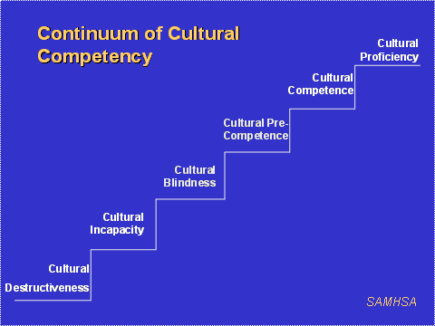
PATH TO CULTURAL COMPETENCY
Notes:
30

Slide 31

We all need Cultural Competence
Everyone will work with people outside their own cultural groups; so they must be able to learn about, relate to, and communicate with people who are different from themselves
To build trust and rapport
To be able to work effectively
Notes:
31

Slide 32

Key Elements of Culturally Competent Organizations and their Staff
Value diversity
Assess themselves
Manage the dynamics of difference
Acquire and institutionalize cultural knowledge
Adapt to diversity and the cultural contexts of individuals and communities served
Notes:
Directions
The facilitator should read the presentation slide. Pass out a handout on the Culturally and Linguistically Appropriate Services Standards (CLAS) (OMH-DHHS, 2000). This information can be retrieved and printed out for the participants in advance of the training by accessing it at: http://minorityhealth.hhs.gov/templates/browse.aspx?lvl=2&lvlID=15
Share Talking Points
The 14 CLAS Standards are based on an analytical review of key laws, regulations, contracts, and standards currently in use by federal and state agencies and other national organizations. The goal of the standards is to increase access to care and contribute to the elimination of health disparities. In addition, organizations striving to meet these standards demonstrate clearly that they value and honor the diverse populations served.

Slide 33
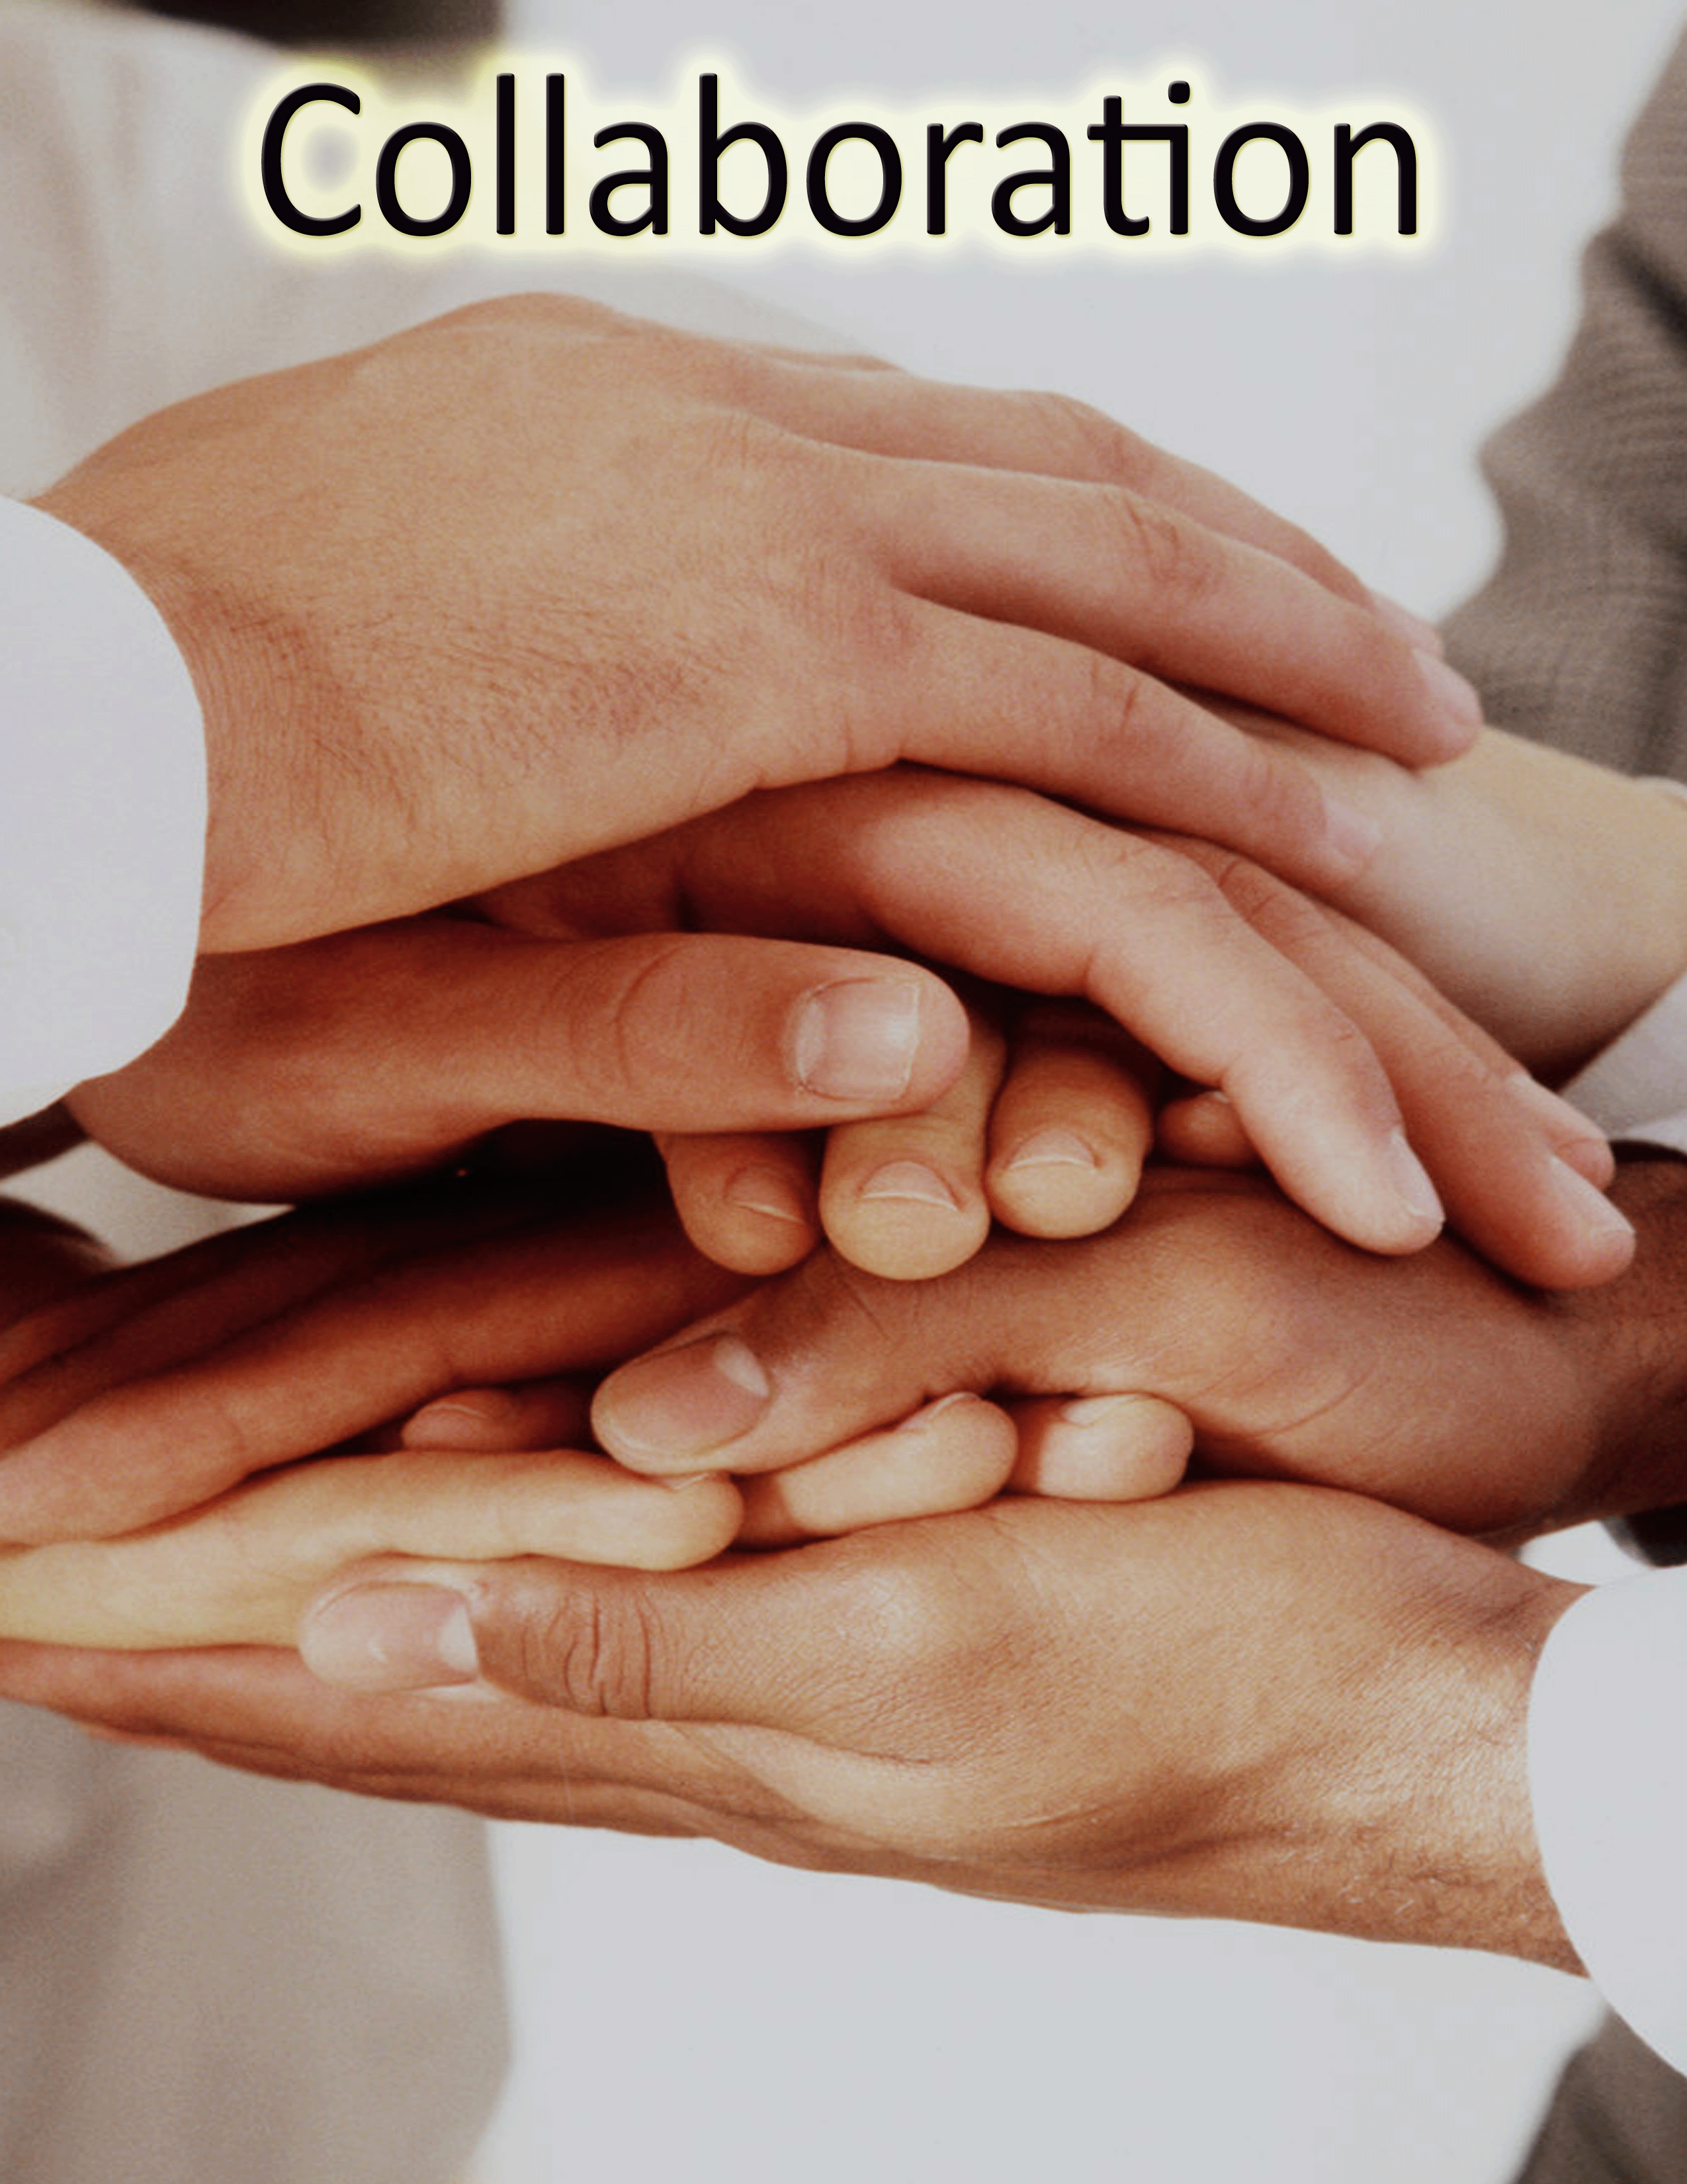
Exploring Strategies to Enhance
Cultural Competence so…
Together, we can move Forward!
Celebrate what works!
What does your agency do or what do you do to effectively work with and serve the diverse groups in your community?

Slide 34
Ensuring Cultural Competence at the Organizational Level
Staff Development: An organization's efforts to ensure staff and other service providers have the requisite attitudes, knowledge and skills for delivering culturally-competent services.
Organizational Infrastructure: The organizational resources required to deliver or facilitate delivery of culturally-competent services.
Services/Interventions: The degree to which the organization delivers services in a culturally competent manner.

Slide 35
Leading with
Cultural Intelligence (CQ)
Read (i.e., local paper when you travel)
Go to the movies / museum
Eat out
Learn a new language
Attend cultural celebrations
Find a cultural coach
Visit a temple, mosque, church
Consume a variety of news sources
Look for culture
Join a multicultural group
Take a class
Create a faith club
D. Livermore, 2010
Notes:
35

Slide 36
Take Home Messages
Cultural Competence = Relationship Building
INDIVIDUAL - Get to know yourself (worldview, values, cultural identities) so you can better explore the uniqueness of others
ORGANIZATION - Get to know your community (traditions, cultures, norms, practices, beliefs) so your agency can be more in tune with their assets & needs
SYSTEMS – Get to know your agency (culture, mission, values, staff, services, polices, practices, philosophies) so you can better serve the community

Slide 37

Questions or Comments?

